Slide 1
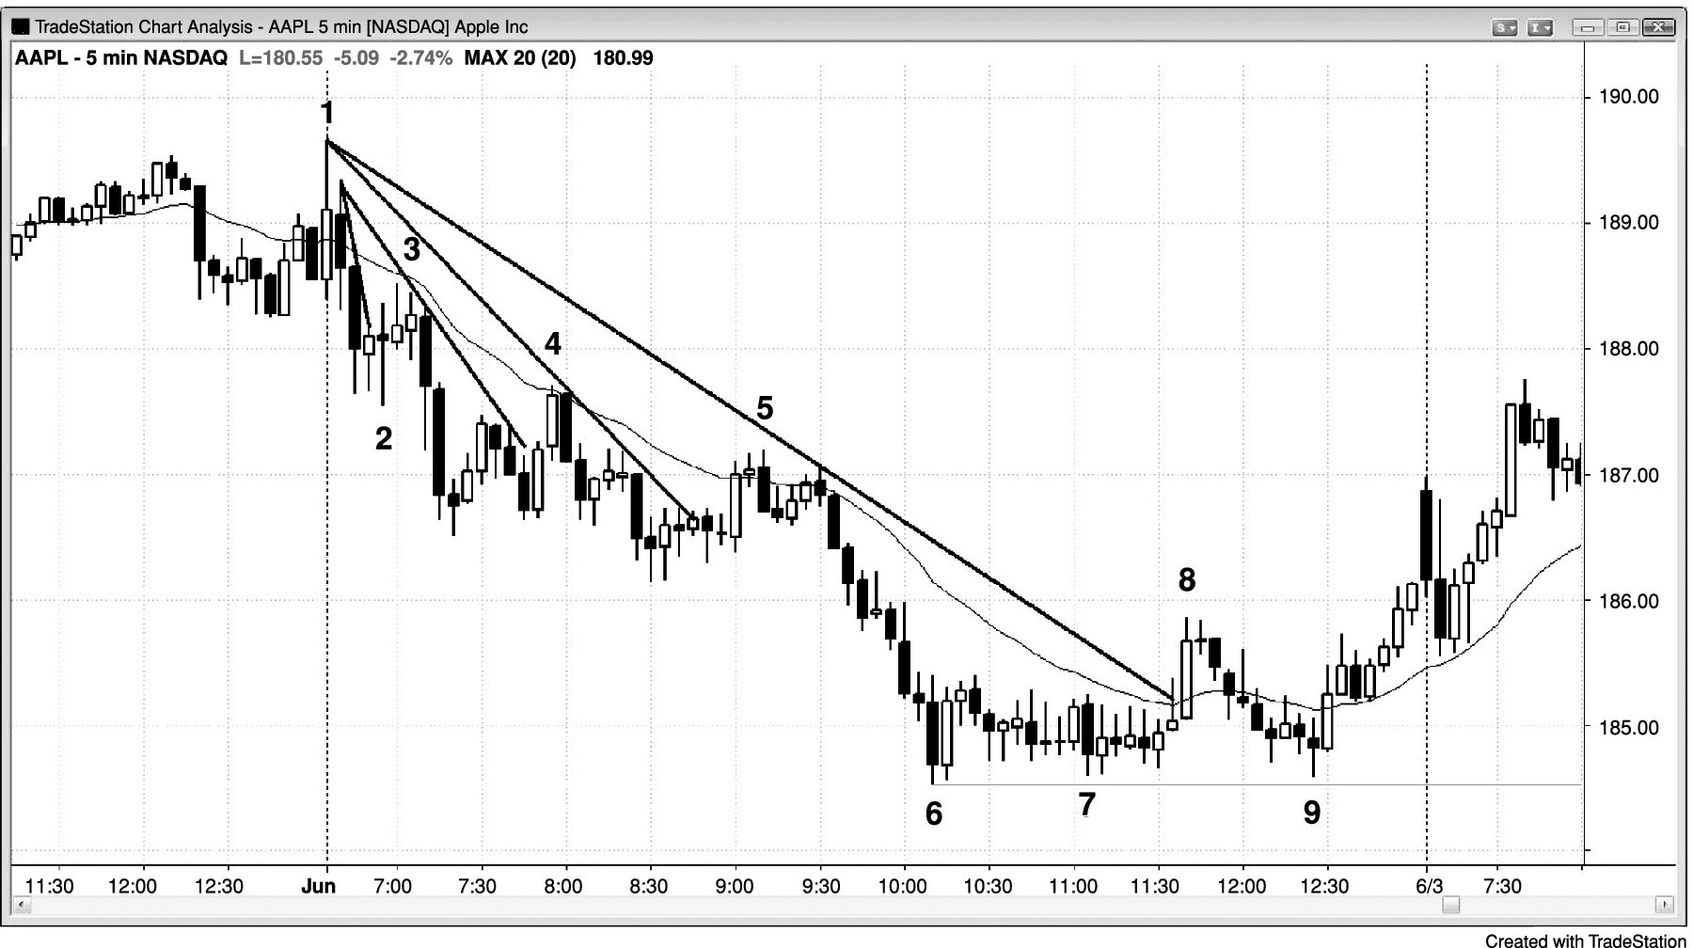
FIGURE 11.1 Subsequent Pullbacks Tend to Get Larger

Slide 2
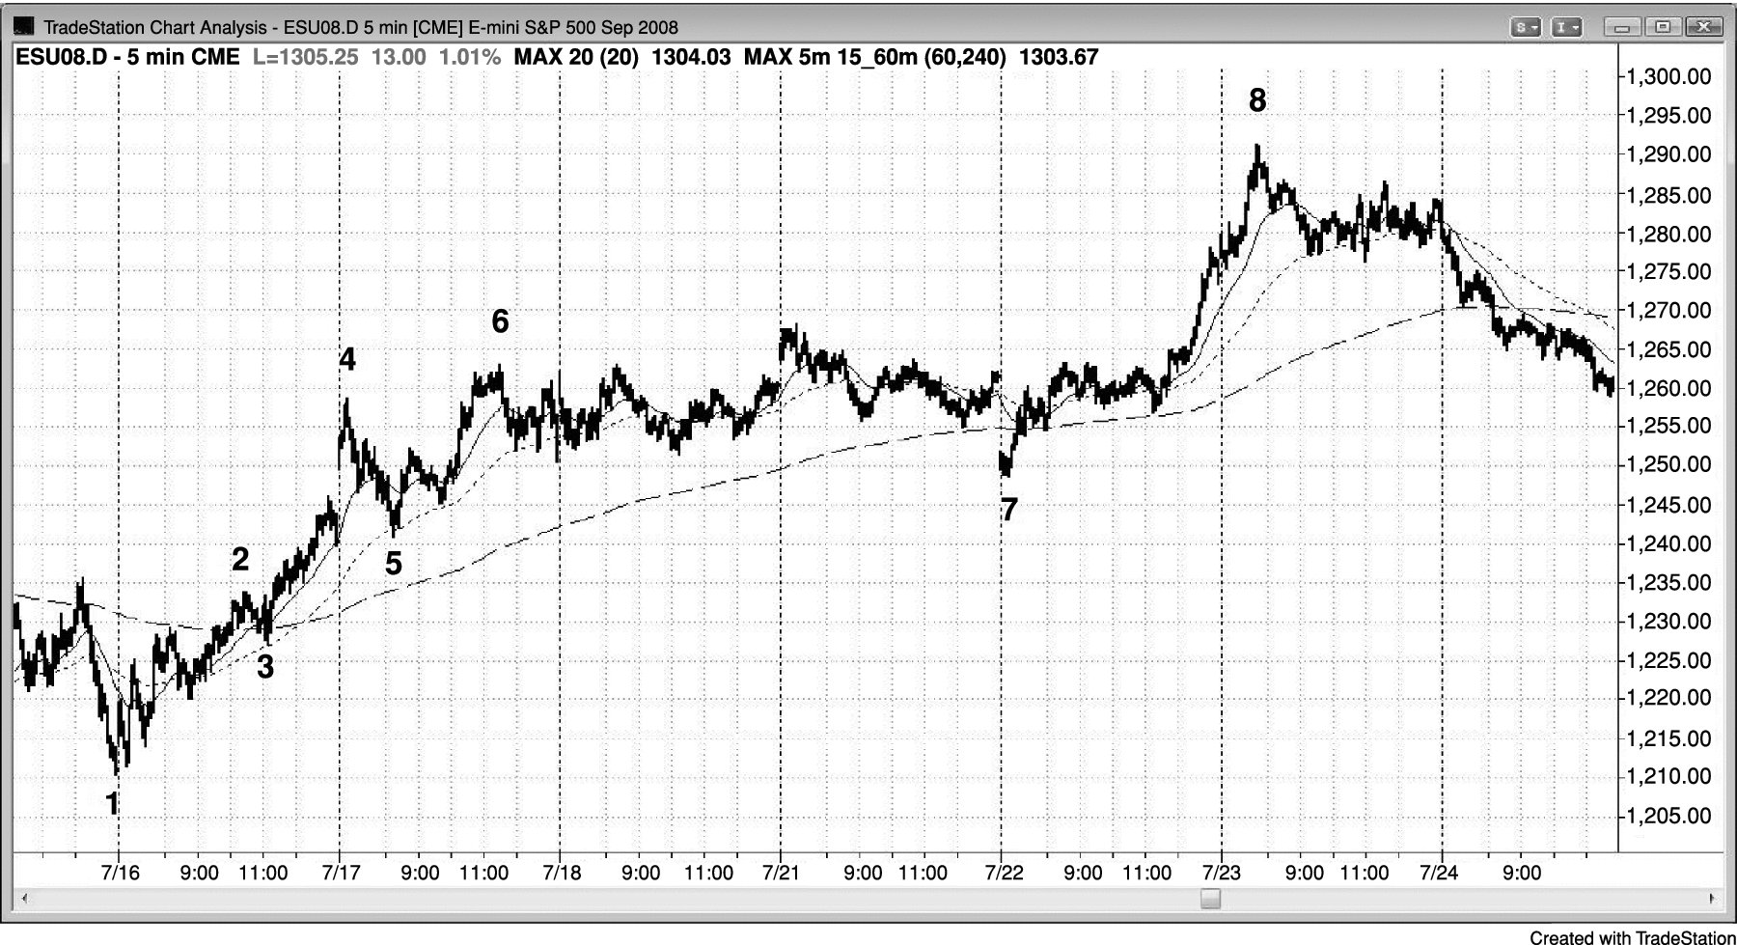
FIGURE 11.2 Moving Average Pullbacks

